Slide 1
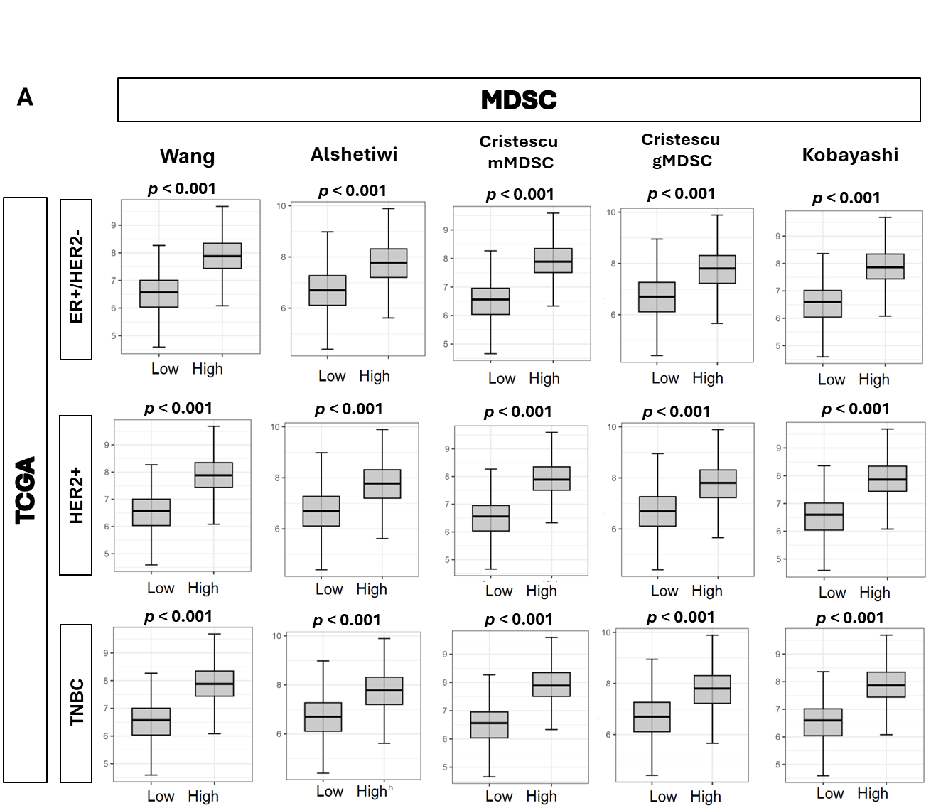
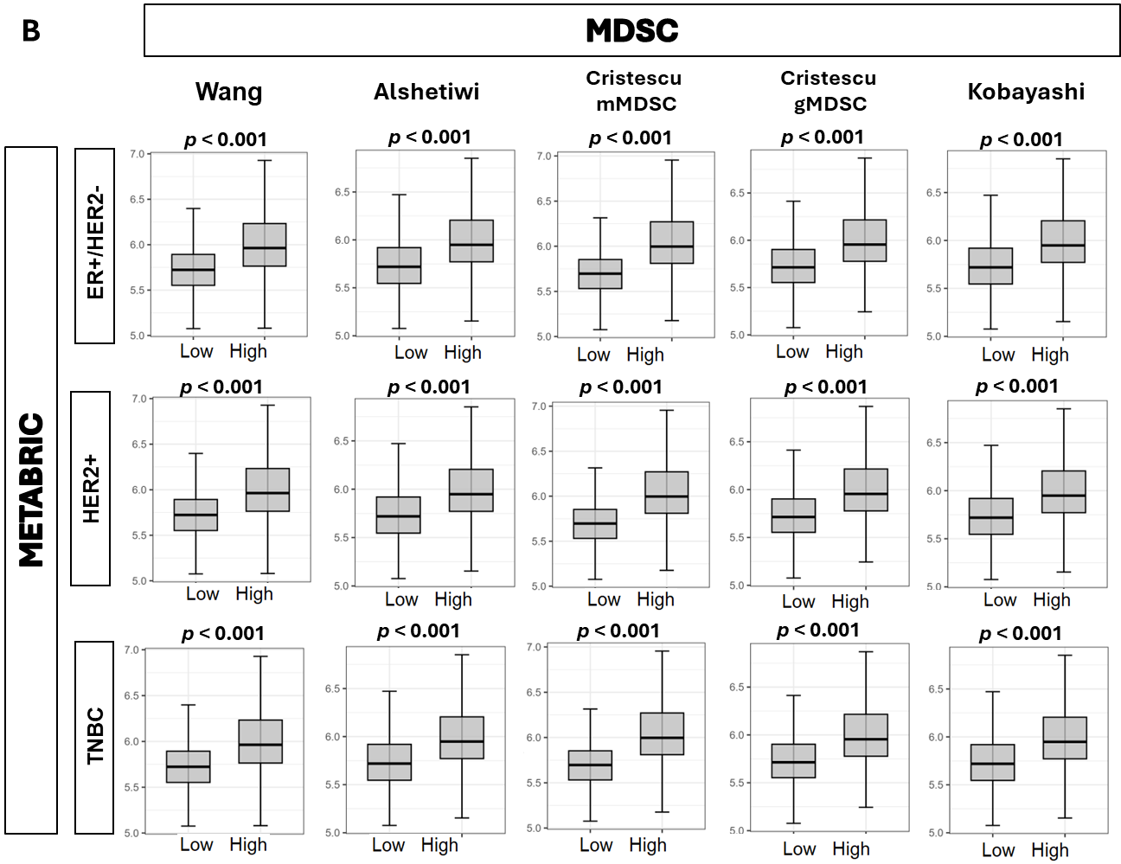
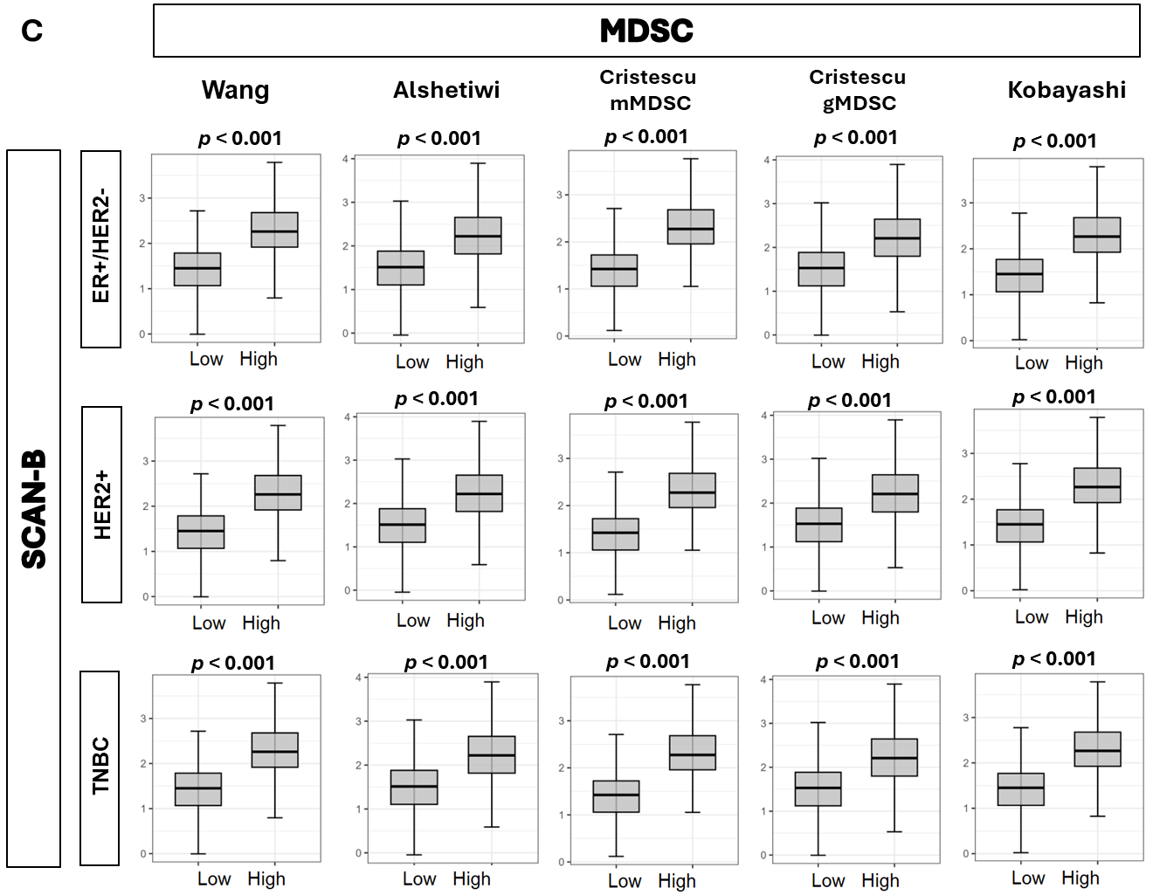
Suppl 2. Association of tumor BTK expression with myeloid derived suppressor cell (MDSC) gene expression signatures. MDSC gene expression signatures, Wang, Alshetaiwi, Cristecu granulocytic MDSC (gMDSC), Cristecu monocytic MDSC (mMDSC), and Kobayashi. A. TCGA, B. METABRIC, C. SCAN-B cohorts.

