Slide 1
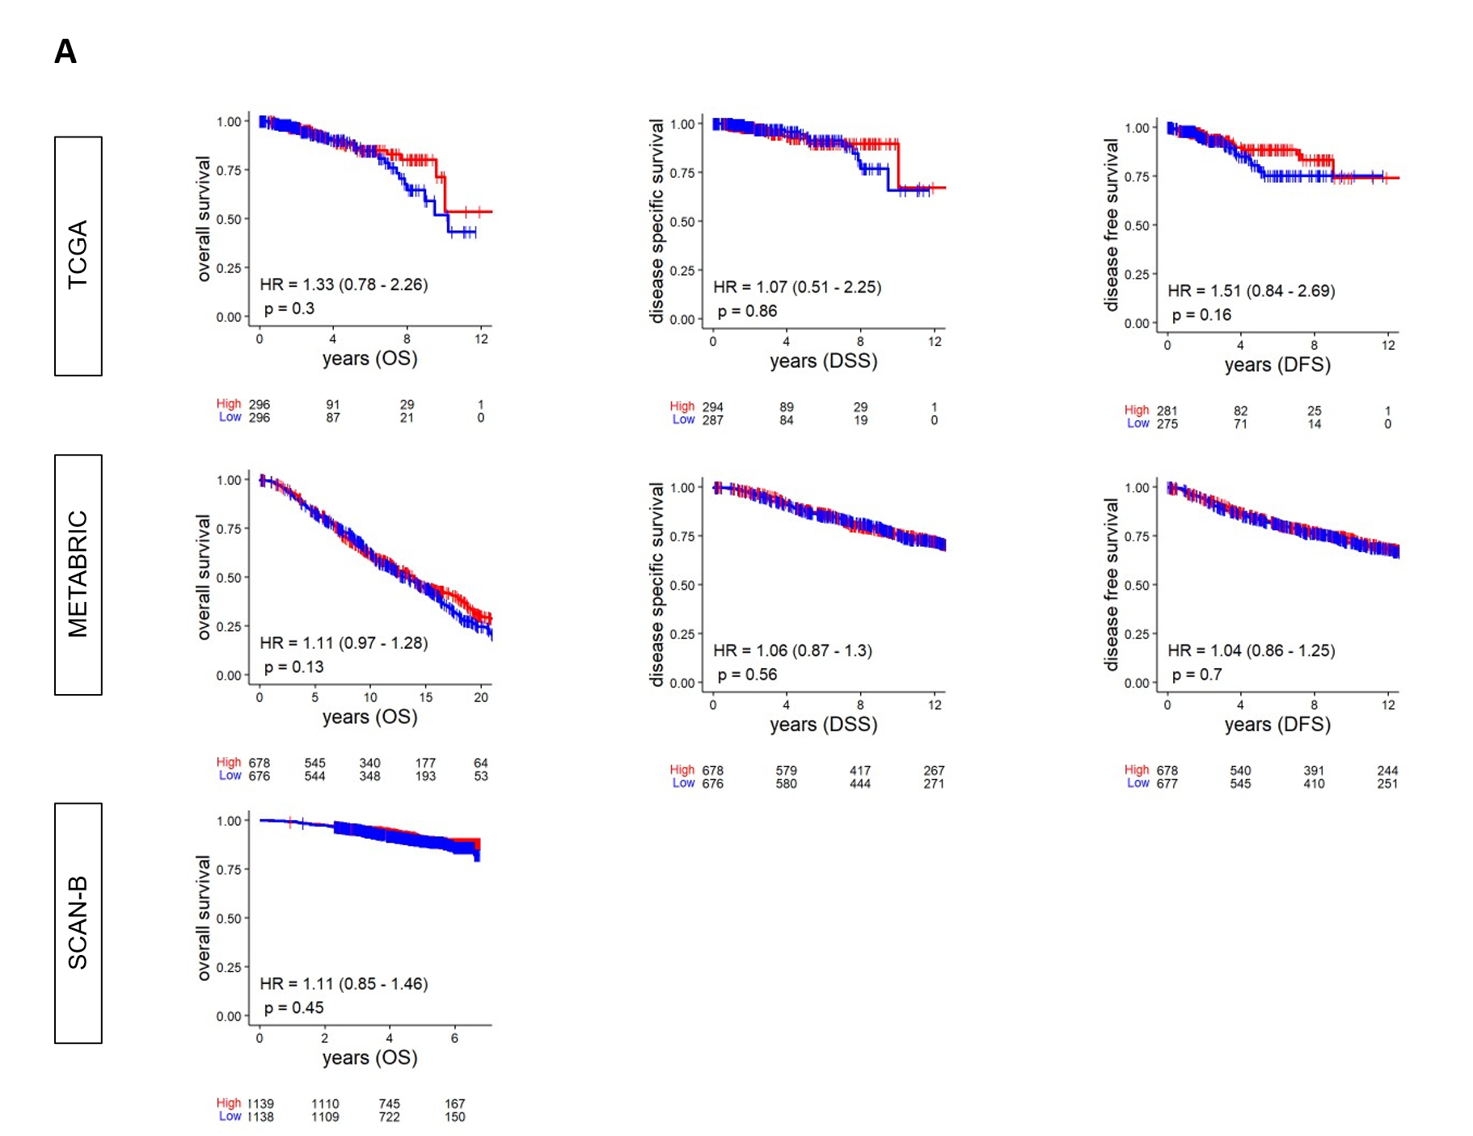
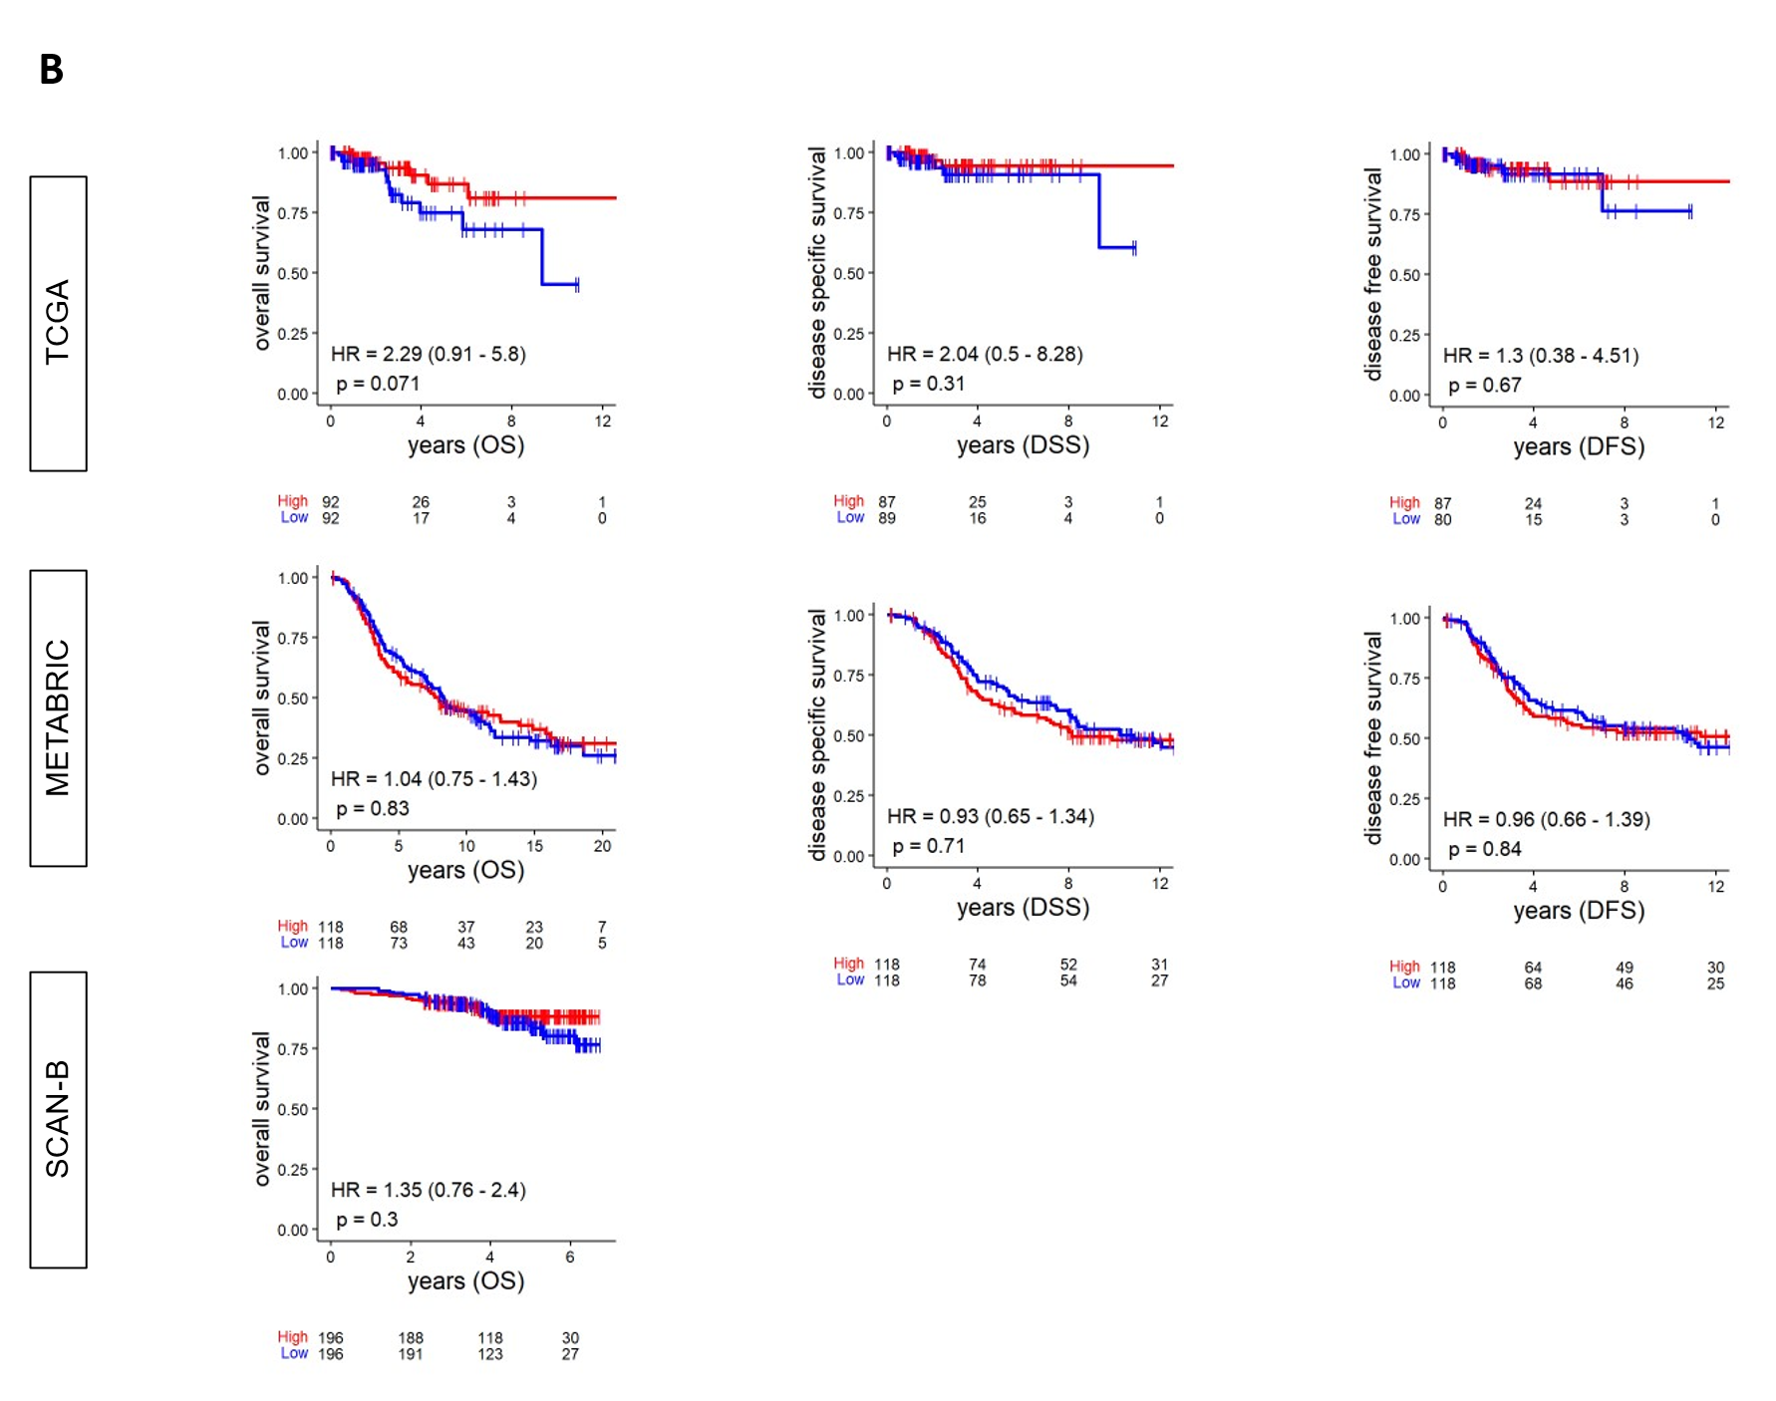
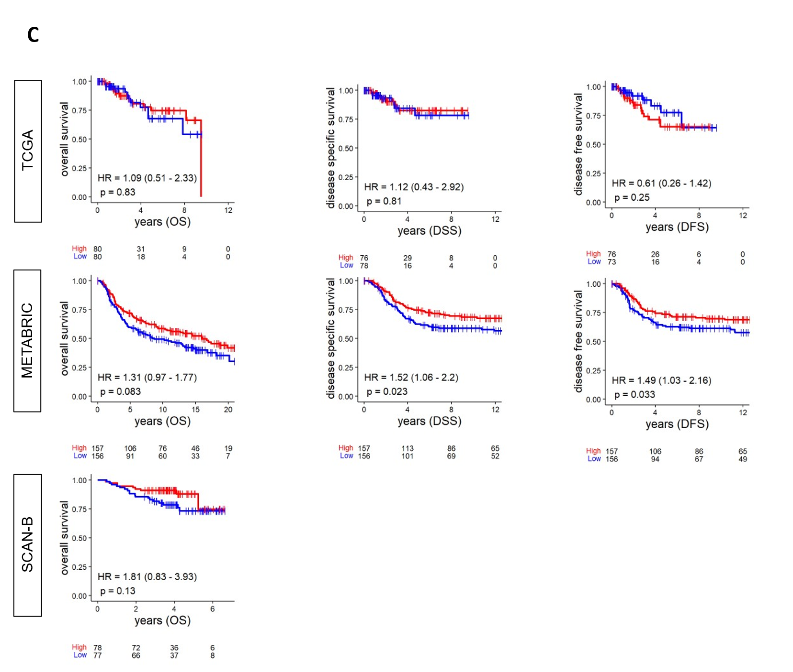
Suppl 1. Estimated survival (Kaplan-Meier) with log-rank test p value and hazard ratio (HR) of disease-free survival (DFS), disease-specific survival (DSS), and overall survival (OS) for breast cancer subtypes groups of patients with low and high BTK expressions within the cohorts, using median value as cut-off. A. ER+/HER2-. B. HER2+. C.TNBC.

